Slide 1

SPARK

Slide 2
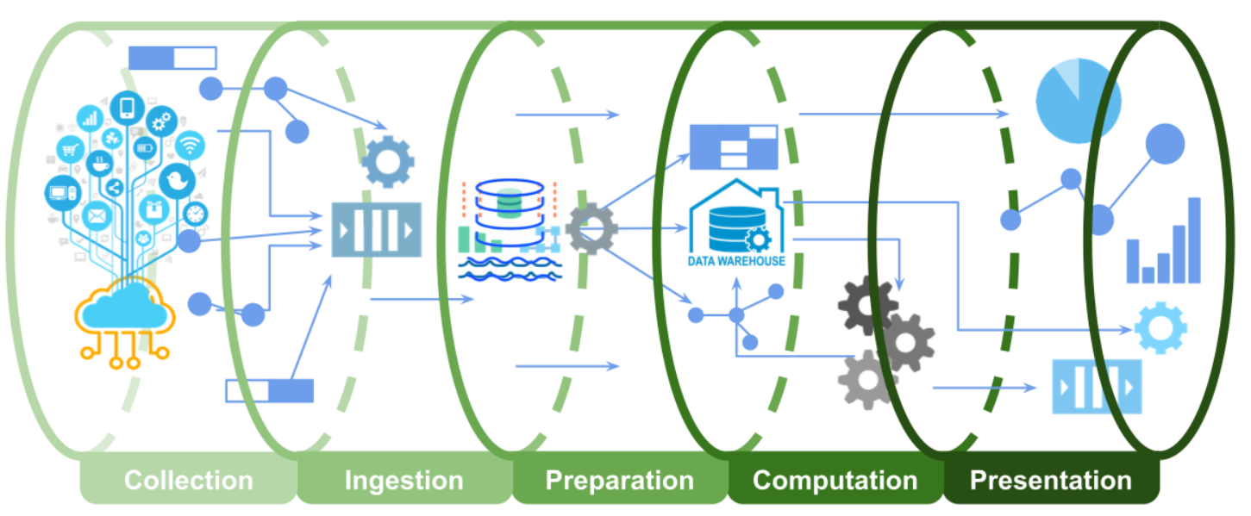
A data pipeline has five stages grouped into three heads:
Data Engineering: collection, ingestion, preparation (~50% effort)
Analytics / Machine Learning: computation (~25% effort)
Delivery: presentation (~25% effort)

Slide 3
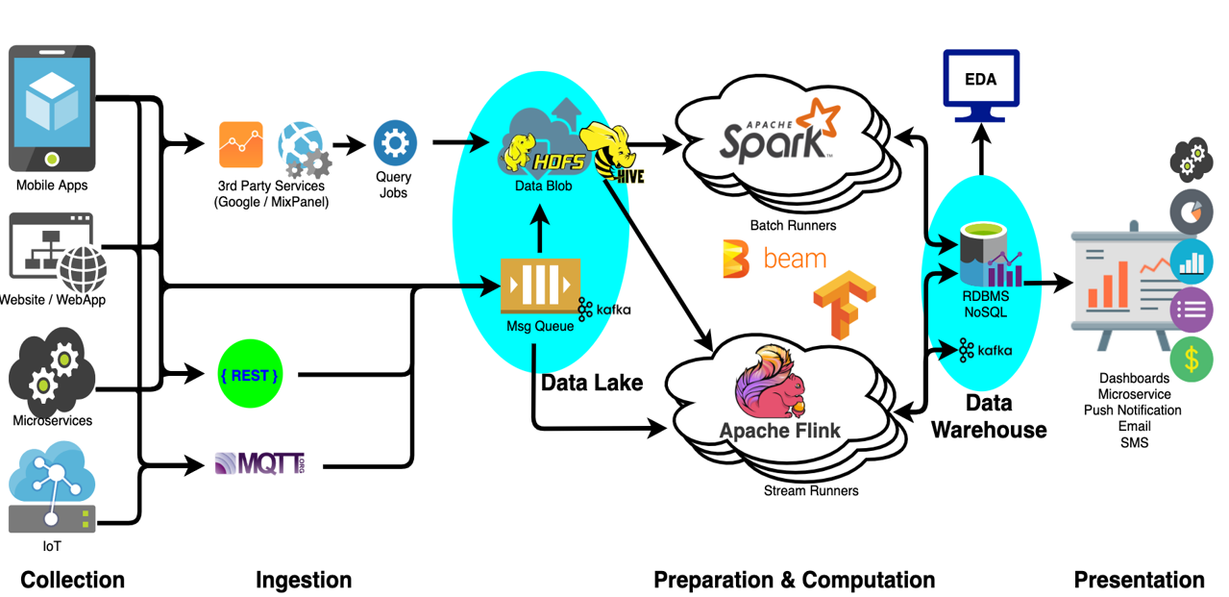

Slide 4
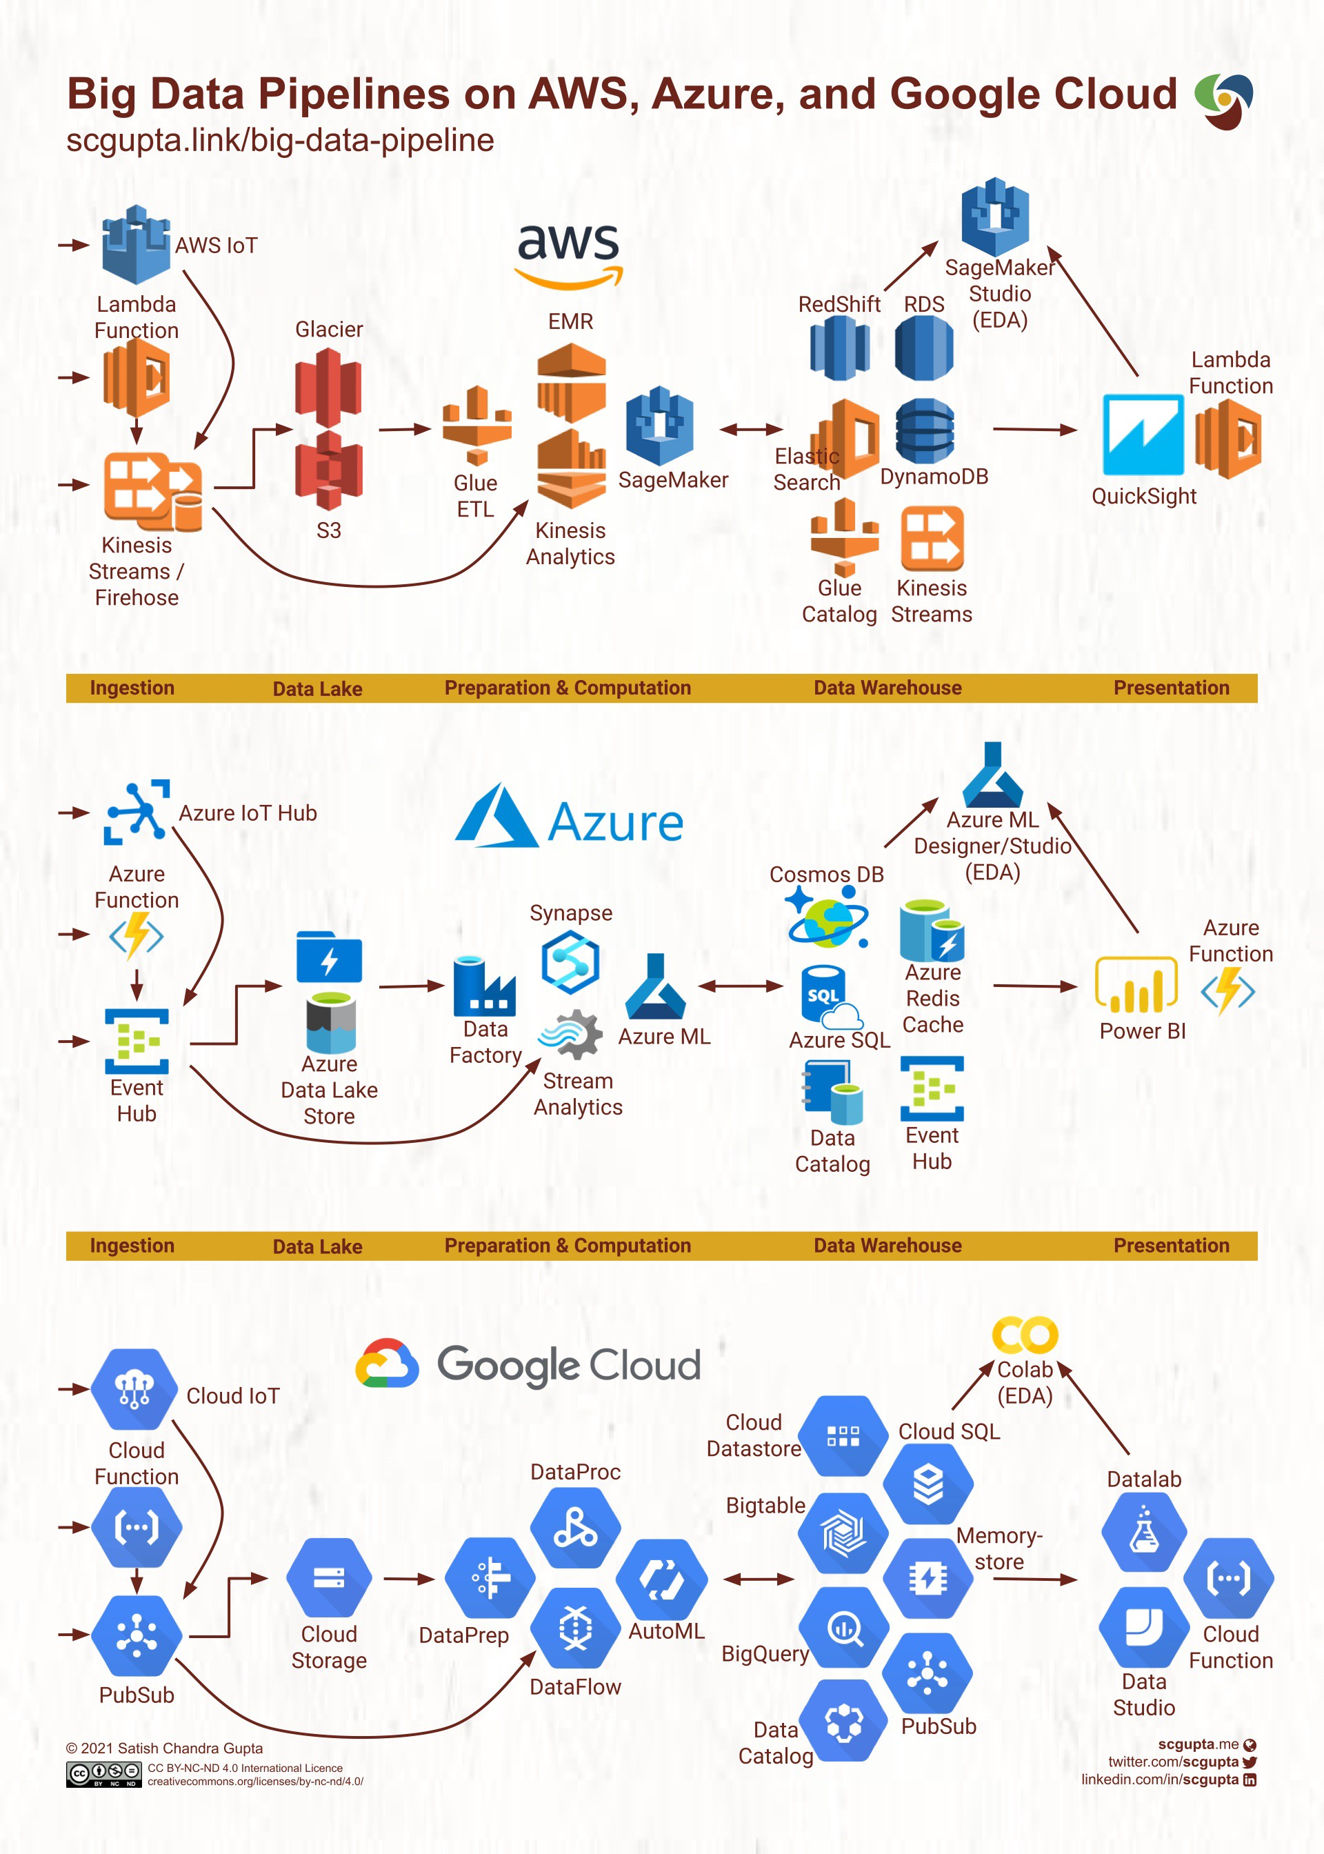

Slide 5
Contents
Creating Spark EMR Cluster
Spark Cluster mode
Introduction to YARN

Slide 6
Creating Spark EMR Cluster
The following procedure creates a cluster with Spark installed using Quick Options in the EMR console.
You can alternatively use Advanced Options to further customize your cluster setup, or to submit steps to programmatically install applications and then run custom applications.
With either cluster creation option, you can choose to use AWS Glue as your Spark SQL metastore.

Slide 7
To launch a cluster with Spark installed
Open the Amazon EMR console at https://console.aws.amazon.com/elasticmapreduce/.
Choose Create cluster to use Quick Options.
Enter a Cluster name.
For Software Configuration, choose a Release option.
For Applications, choose the Spark application bundle.
Select other options as necessary and then choose Create cluster.

Slide 8
To launch a cluster with Spark installed using the AWS CLI
Create the cluster with the following command.

Slide 9
To launch a cluster with Spark installed using the SDK for Java
Specify Spark as an application with SupportedProductConfig used in RunJobFlowRequest.
The following example shows how to create a cluster with Spark using Java.
import com.amazonaws.AmazonClientException;
import com.amazonaws.auth.AWSCredentials;
import com.amazonaws.auth.AWSStaticCredentialsProvider;

Slide 10
import com.amazonaws.auth.profile.ProfileCredentialsProvider;
import com.amazonaws.services.elasticmapreduce.AmazonElasticMapReduce;
import com.amazonaws.services.elasticmapreduce.AmazonElasticMapReduceClientBuilder;
import com.amazonaws.services.elasticmapreduce.model.*;
import com.amazonaws.services.elasticmapreduce.util.StepFactory;
public class Main {
public static void main(String[] args) {
AWSCredentials credentials_profile = null;
try {
credentials_profile = new ProfileCredentialsProvider("default").getCredentials();
} catch (Exception e) {

Slide 11
throw new AmazonClientException(
"Cannot load credentials from .aws/credentials file. " +
"Make sure that the credentials file exists and the profile name is specified within it.",
e);
}
AmazonElasticMapReduce emr = AmazonElasticMapReduceClientBuilder.standard()
.withCredentials(new AWSStaticCredentialsProvider(credentials_profile))
.withRegion(Regions.US_WEST_1)
.build();

Slide 12
// create a step to enable debugging in the AWS Management Console
StepFactory stepFactory = new StepFactory();
StepConfig enabledebugging = new StepConfig()
.withName("Enable debugging")
.withActionOnFailure("TERMINATE_JOB_FLOW")
.withHadoopJarStep(stepFactory.newEnableDebuggingStep());
Application spark = new Application().withName("Spark");

Slide 13
RunJobFlowRequest request = new RunJobFlowRequest()
.withName("Spark Cluster")
.withReleaseLabel("emr-5.20.0")
.withSteps(enabledebugging)
.withApplications(spark)
.withLogUri("s3://path/to/my/logs/")
.withServiceRole("EMR_DefaultRole")
.withJobFlowRole("EMR_EC2_DefaultRole")
withInstances(new JobFlowInstancesConfig()
.withEc2SubnetId("subnet-12ab3c45")
.withEc2KeyName("myEc2Key")

Slide 14
.withInstanceCount(3)
.withKeepJobFlowAliveWhenNoSteps(true)
.withMasterInstanceType("m4.large")
.withSlaveInstanceType("m4.large")
);
RunJobFlowResult result = emr.runJobFlow(request);
System.out.println("The cluster ID is " + result.toString());
}
}

Slide 15
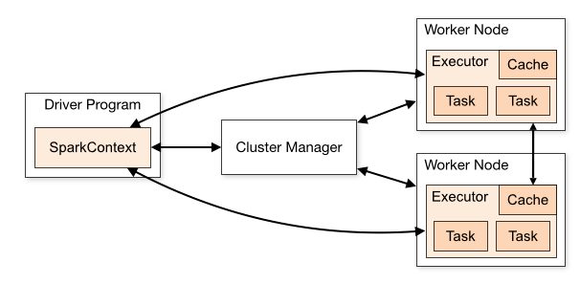
Spark Cluster mode

Slide 16
Components
Spark applications run as independent sets of processes on a cluster, coordinated by the SparkContext object in your main program (called the driver program).
Specifically, to run on a cluster, the SparkContext can connect to several types of cluster managers (either Spark’s own standalone cluster manager, Mesos or YARN), which allocate resources across applications.

Slide 17
Once connected, Spark acquires executors on nodes in the cluster, which are processes that run computations and store data for your application.
Next, it sends your application code (defined by JAR or Python files passed to SparkContext) to the executors.
Finally, SparkContext sends tasks to the executors to run.

Slide 18
There are several useful things to note about this architecture:
Each application gets its own executor processes, which stay up for the duration of the whole application and run tasks in multiple threads. This has the benefit of isolating applications from each other, on both the scheduling side (each driver schedules its own tasks) and executor side (tasks from different applications run in different JVMs). However, it also means that data cannot be shared across different Spark applications (instances of SparkContext) without writing it to an external storage system.

Slide 19
Spark is agnostic to the underlying cluster manager. As long as it can acquire executor processes, and these communicate with each other, it is relatively easy to run it even on a cluster manager that also supports other applications (e.g. Mesos/YARN).
The driver program must listen for and accept incoming connections from its executors throughout its lifetime (e.g., see spark.driver.port in the network config section). As such, the driver program must be network addressable from the worker nodes.

Slide 20
Because the driver schedules tasks on the cluster, it should be run close to the worker nodes, preferably on the same local area network. If you’d like to send requests to the cluster remotely, it’s better to open an RPC to the driver and have it submit operations from nearby than to run a driver far away from the worker nodes.

Slide 21
Cluster Manager Types
The system currently supports several cluster managers:
Standalone – a simple cluster manager included with Spark that makes it easy to set up a cluster.
Apache Mesos – a general cluster manager that can also run Hadoop MapReduce and service applications.
Hadoop YARN – the resource manager in Hadoop 2.
Kubernetes – an open-source system for automating deployment, scaling, and management of containerized applications

Slide 22
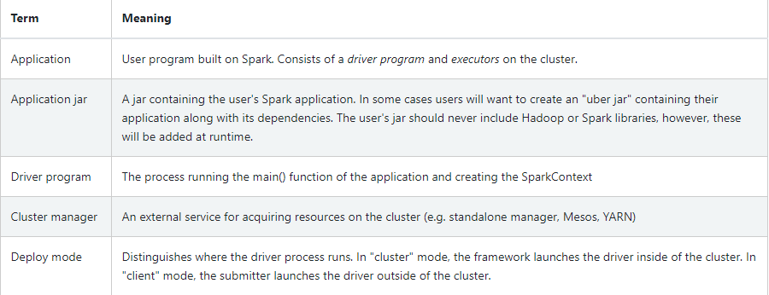
The following table summarizes terms you’ll see used to refer to cluster concepts:

Slide 23
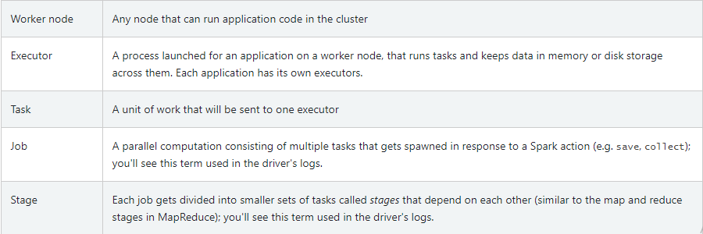

Slide 24

Introduction to YARN
Apache Yarn (Yet Another Resource Negotiator) is the result of the rewrite of Hadoop by Yahoo to separate resource management from job scheduling.
Not only does this improve Hadoop, it means Yarn is a standalone component that you can use with other software, like Apache Spark, or you can write your own application using Yarn, thus making your application run across a distributed architecture.
Yarn does basically the same thing as Mesos. What it does is keep track of available resources (memory, CPU, storage) across the cluster (meaning the machines where Hadoop is running).

Slide 25
Then each application (e.g., Hadoop) asks the resource manager what resources are available and doles those out accordingly.
It runs two daemons to do this: Scheduler and ApplicationsManager.
Yarn uses Linux cgroups to control tasks and keep them within their allocation resource.
Linux cgroups are similar to Docker and Mesos containers.

Slide 26
The goal is to keep the task with its allocated memory, CPU, network, and storage usage, although with Hadoop 2.7 this is limited to limiting CPU.
Yarn is a framework, meaning an API.
In terms of the graphic below, we see the Node Manager querying the Resource Manager to execute and then monitor the MapReduce tasks.

Slide 27
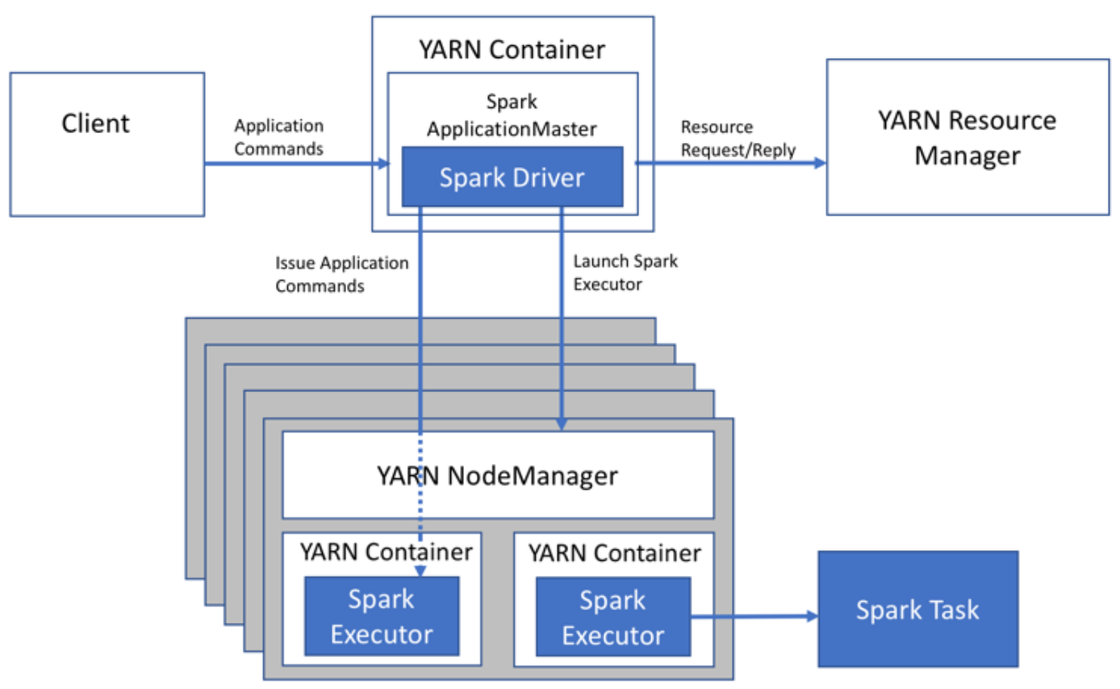

Slide 28
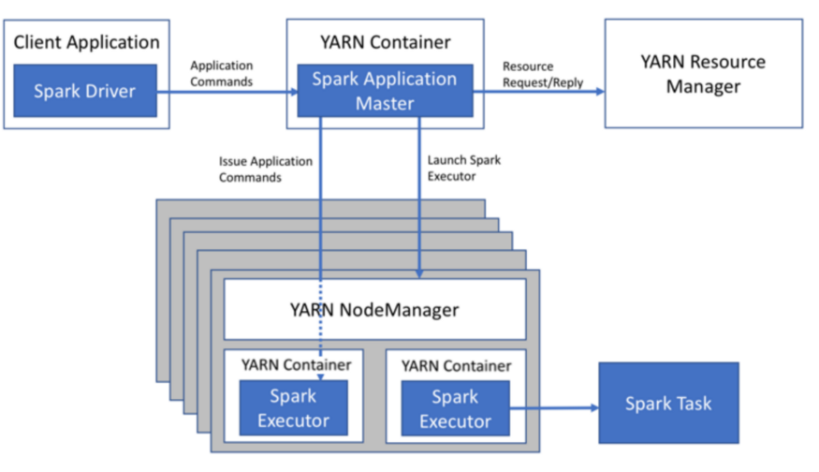

Slide 29
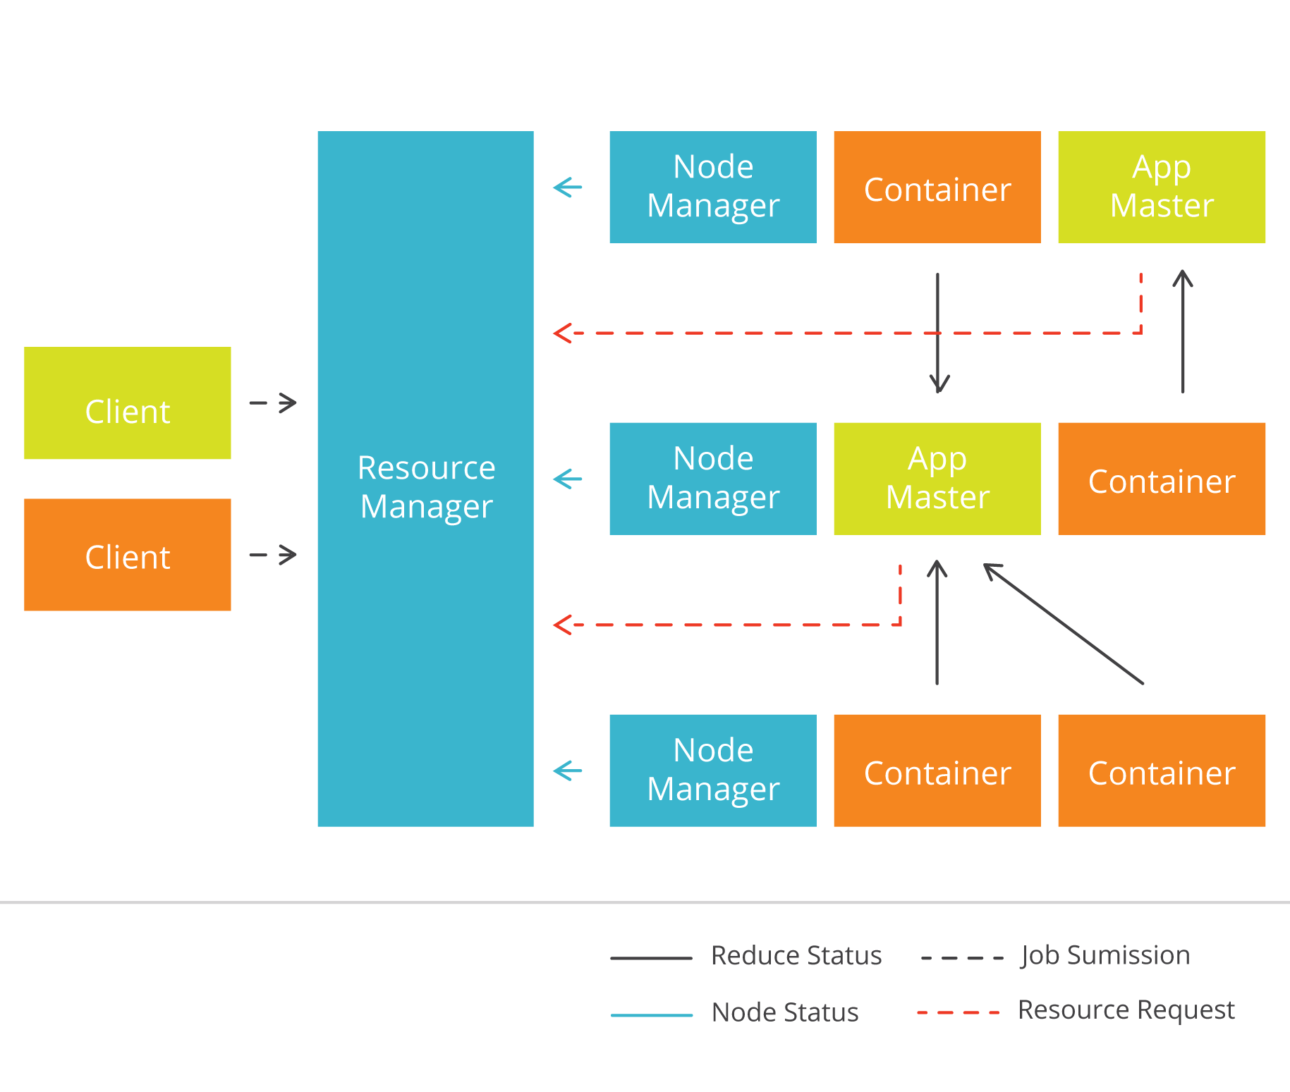

Slide 30
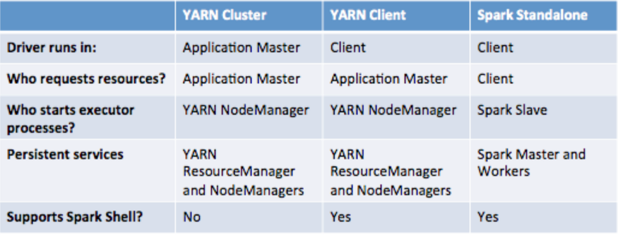

Slide 31
Yarn-site.xml
In Hadoop, the Yarn config file is located in
  $HADOOP_HOME/etc/hadoop/yarn-site.xml.
So are the Hadoop config files.
The default Yarn configuration has only this one property which is all you need for a basic test.
  Yarn.nodemanager.aux-services
  mapreduce_shuffle

Slide 32
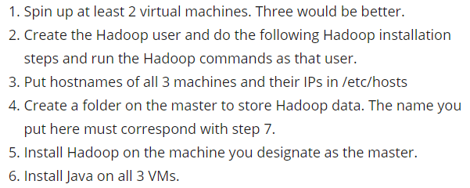
Using Yarn in a Hadoop cluster
The steps to configuring Hadoop to run in a cluster are:

Slide 33
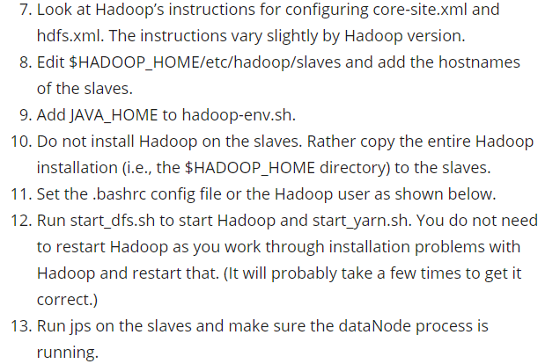

Slide 34
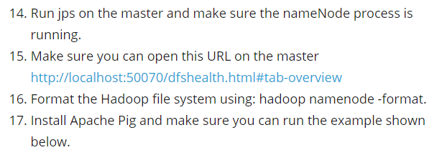
If everything is working step 15 should look should display this webpage:

Slide 35
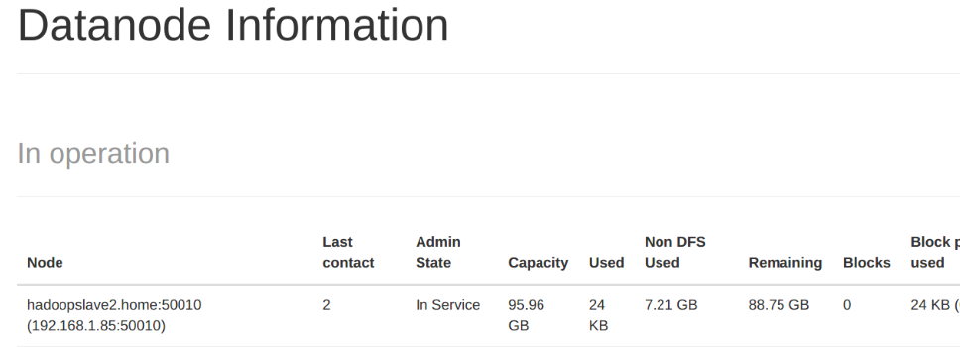
DataNode Information

Slide 36
Yarn command line
You can run Yarn from the command line to get info. But you do not really need it.
The file $YARN_HOME/etc/hadoop/yarn-env.sh is where you override Yarn options for Yarn command line options.
Add the classpath to your environment so you can use Yarn from the command line.
export CLASSPATH=`yarn classpath`:$CLASSPATH
The command Yarn classpath returns all the jar files needed to run yarn.

Slide 37
END OF SESSION
Q&A

